Slide 1
CPE 221: Computer Organization
16 Pipelined ARM Processor
rahul.bhadani@uah.edu

Slide 2
Pipelined ARM Processor​
Temporal parallelism​
Divide single-cycle processor into 5 stages:​
Fetch​
Decode​
Execute​
Memory​
Writeback​
Add pipeline registers between stages​

Slide 3
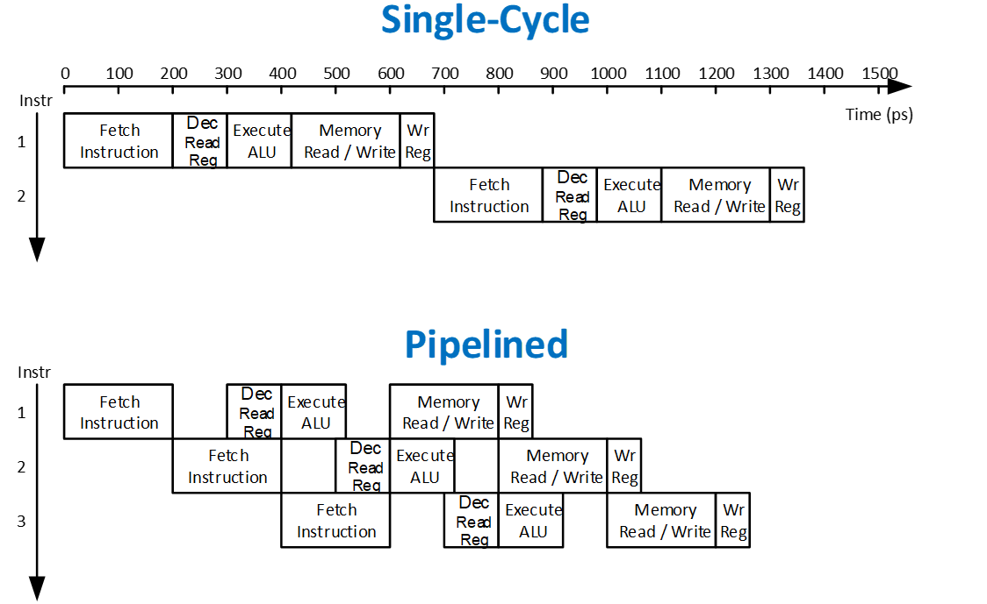
Single-Cycle vs. Pipelined​

Slide 4
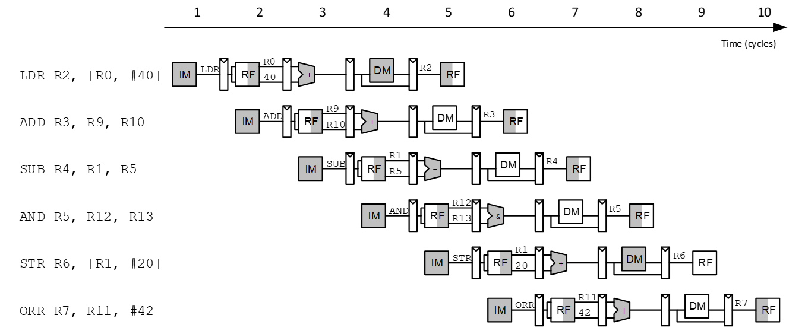
Pipelined Processor Abstraction​

Slide 5
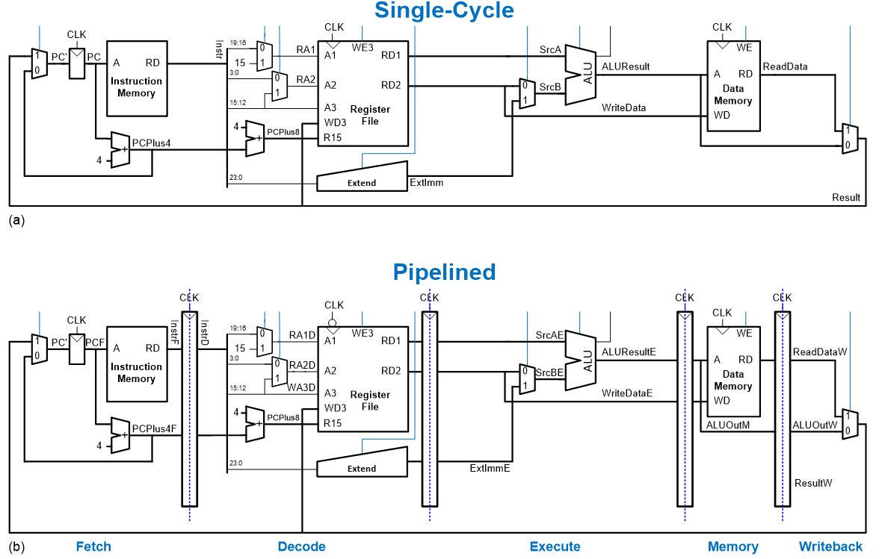
Single-Cycle & Pipelined Datapath​

Slide 6
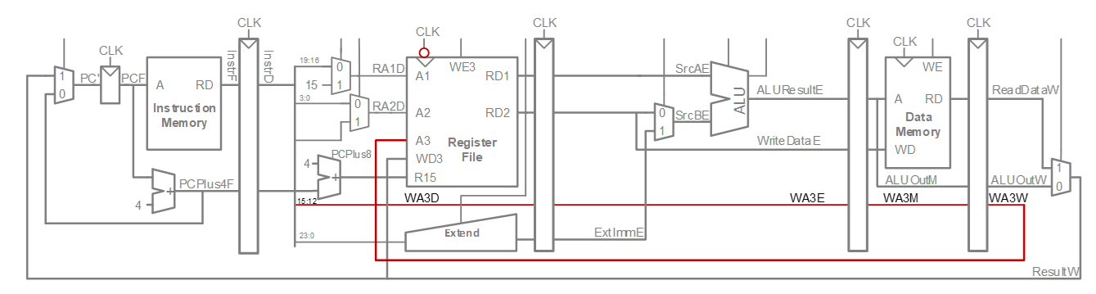
Corrected Pipelined Datapath​
WA3 must arrive at same time as Result​
Register file written on falling edge of CLK​

Slide 7
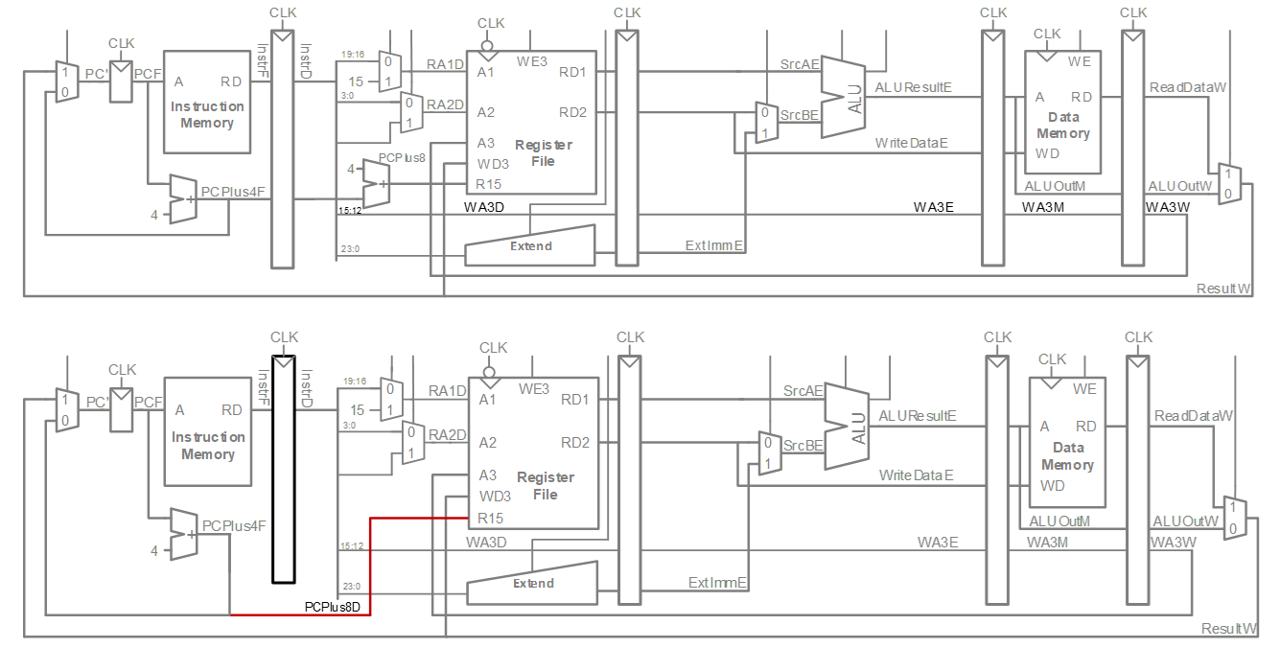
Optimized Pipelined Datapath​
Remove adder by using PCPlus4F after PC has been updated to PC+4​

Slide 8
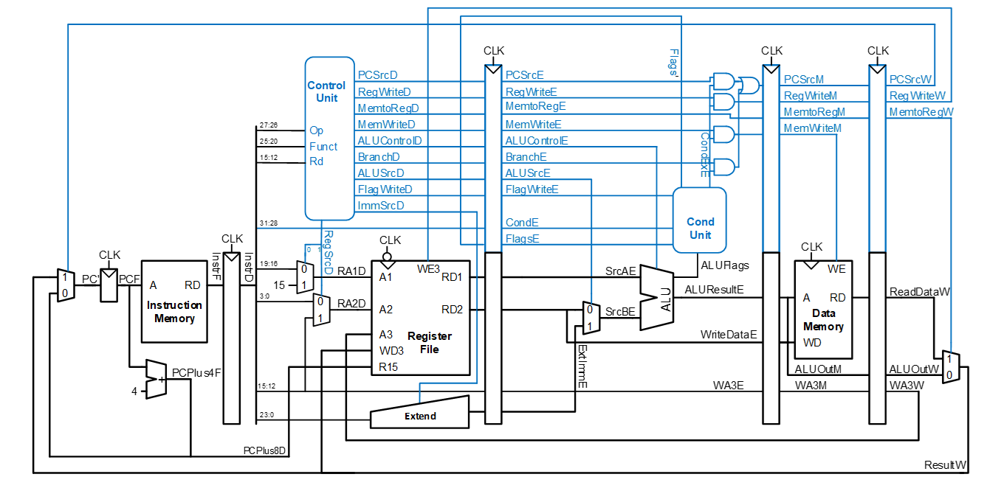
Pipelined Processor Control​
Same control unit as single-cycle processor​
Control delayed to proper pipeline stage​

Slide 9
Pipeline Hazards​
When an instruction depends on result from instruction that hasn’t completed​
Types:​
Data hazard: register value not yet written back to register file​
Control hazard: next instruction not decided yet (caused by branch)​

Slide 10
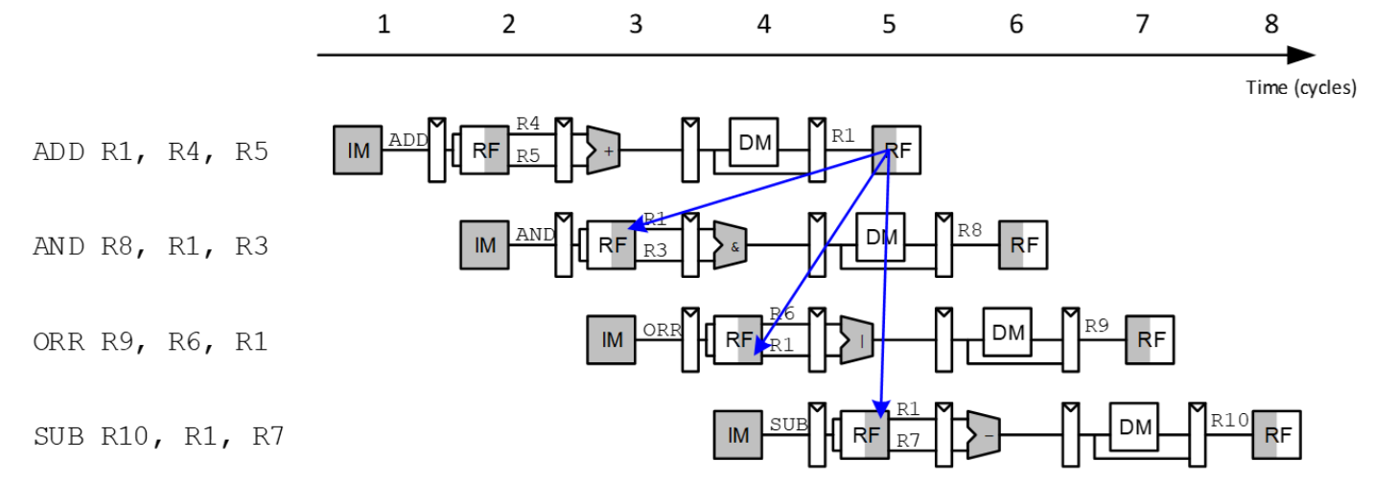
Data Hazard​

Slide 11
Handling Data Hazards​
Insert NOPs in code at compile time​
Rearrange code at compile time​
Forward data at run time​
Stall the processor at run time​

Slide 12
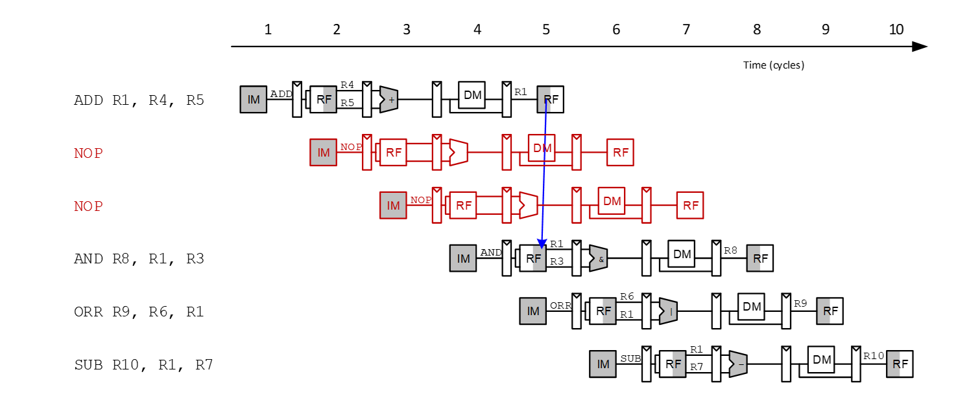
Compile-Time Hazard Elimination​
Insert enough NOPs for result to be ready​
Or move independent useful instructions forward​

Slide 13
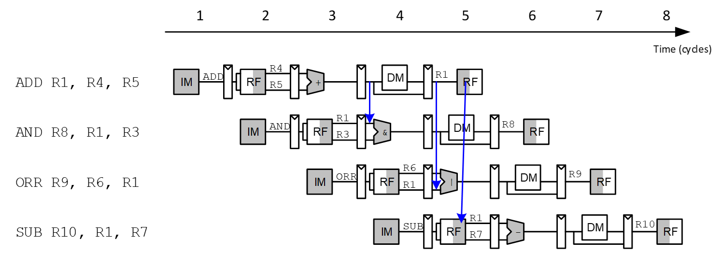
Forward Data at Run Time​
Check if register read in Execute stage matches register written in Memory or Writeback stage ​
If so, forward the result​

Slide 14
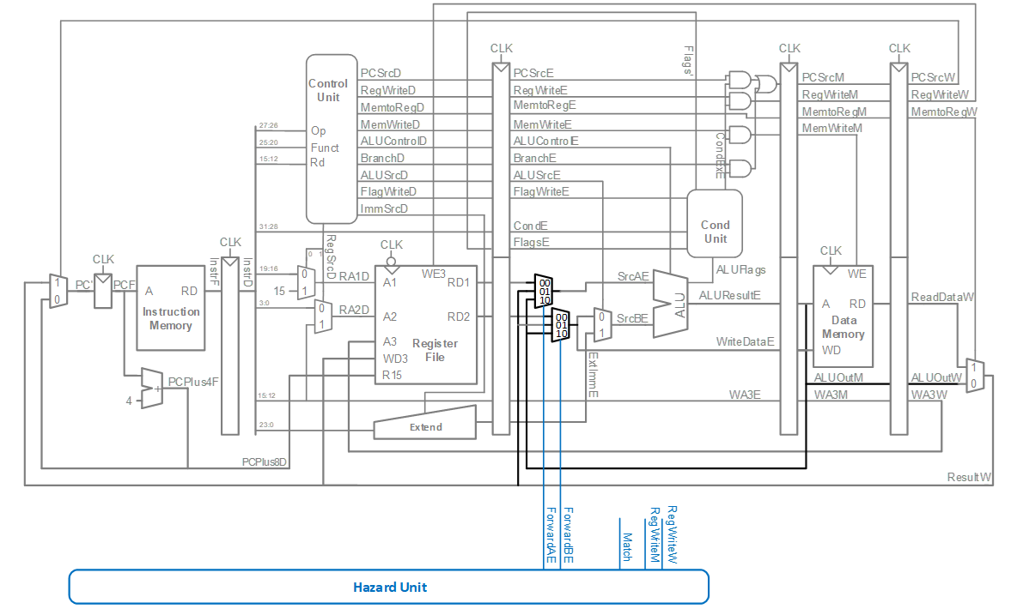
Data Forwarding

Slide 15
Data Forwarding​
Execute stage register matches Memory stage register?​
Match_1E_M = (RA1E == WA3M)​
Match_2E_M = (RA2E == WA3M)​
​
Execute stage register matches Writeback stage register?​
Match_1E_W = (RA1E == WA3W)​
Match_2E_W = (RA2E == WA3W)​
​
If it matches, forward result:​
​
if (Match_1E_M • RegWriteM) ForwardAE = 10; ​
else if (Match_1E_W • RegWriteW) ForwardAE = 01; ​
else ForwardAE = 00;​
​
​ForwardBE same but with Match2E​

Slide 16
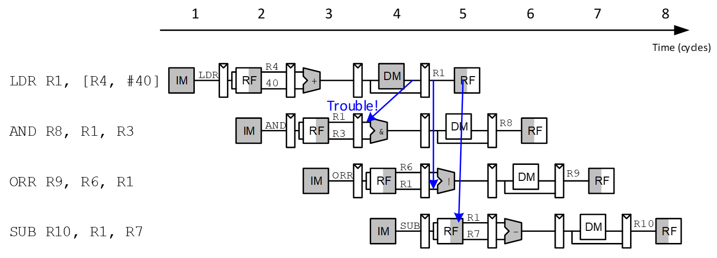
Stalling​

Slide 17
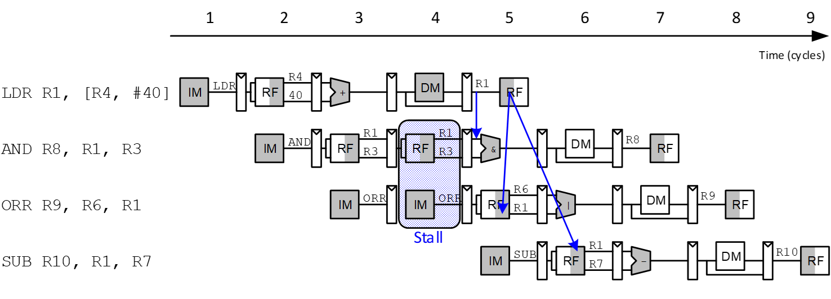
Stalling

Slide 18
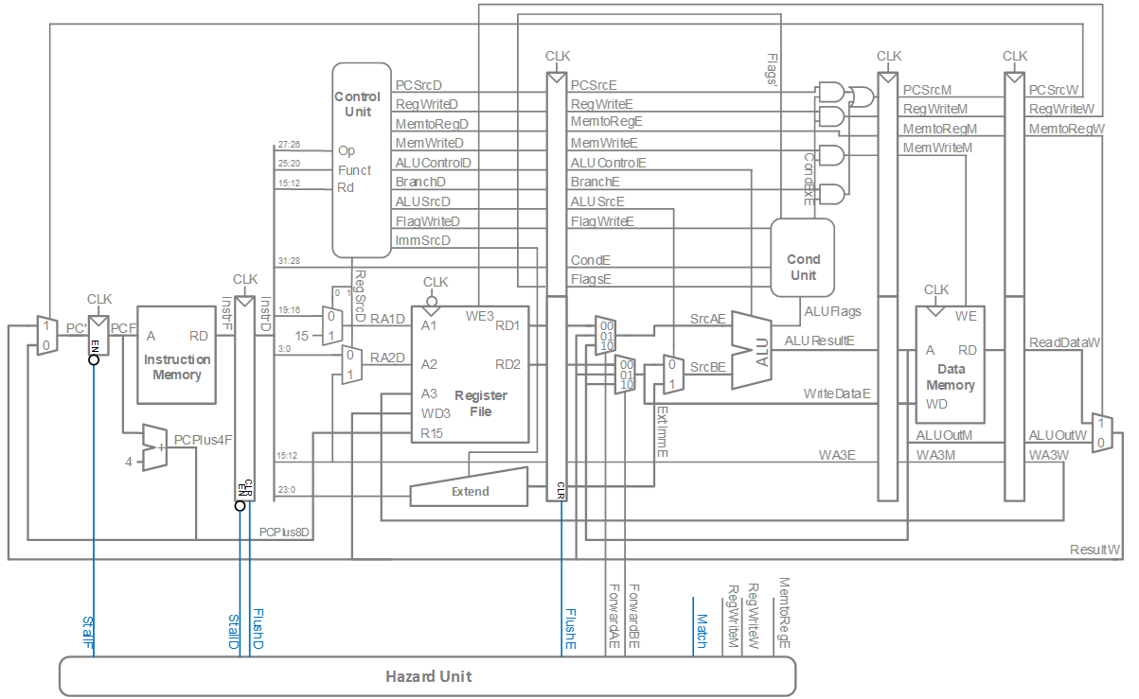
Stalling Hardware​

Slide 19
Stalling Logic​
Is either source register in the Decode stage the same as the one being written in the Execute stage?​
​
Match_12D_E = (RA1D == WA3E) + (RA2D == WA3E)​
​
Is a LDR in the Execute stage AND Match_12D_E?​
​
ldrstall = Match_12D_E • MemtoRegE​
StallF = StallD = FlushE = ldrstall​

Slide 20
Control Hazards​
B: ​
branch not determined until the Writeback stage of pipeline​
Instructions after branch fetched before branch occurs​
These 4 instructions must be flushed if branch happens​
Writes to PC (R15) similar​

Slide 21
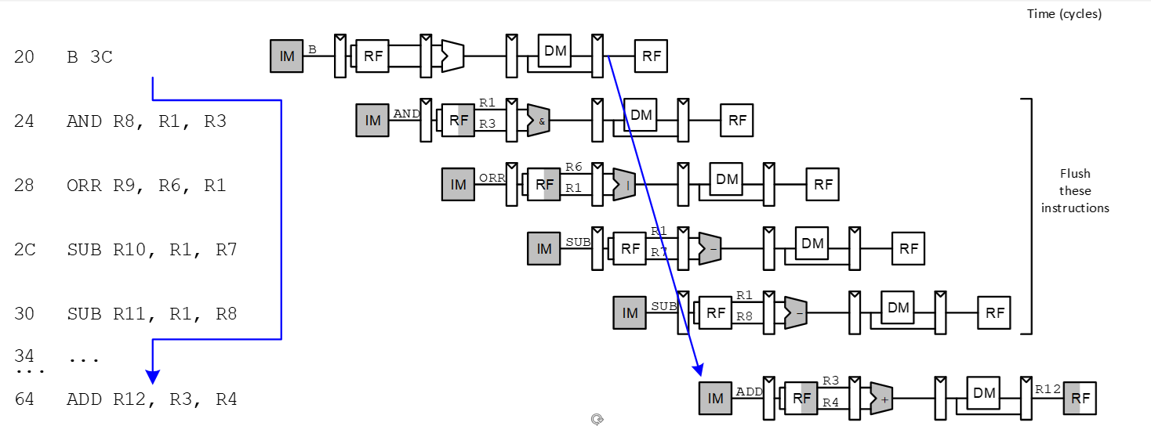
Control Hazards​
Branch misprediction penalty​
number of instruction flushed when branch is taken (4)​
May be reduced by determining BTA earlier

Slide 22
Early Branch Resolution​
Determine BTA in Execute stage​
Branch misprediction penalty = 2 cycles​
Hardware changes​
Add a branch multiplexer before PC register to select BTA from ALUResultE​
Add BranchTakenE select signal for this multiplexer (only asserted if branch condition satisfied)​
PCSrcW now only asserted for writes to PC ​

Slide 23
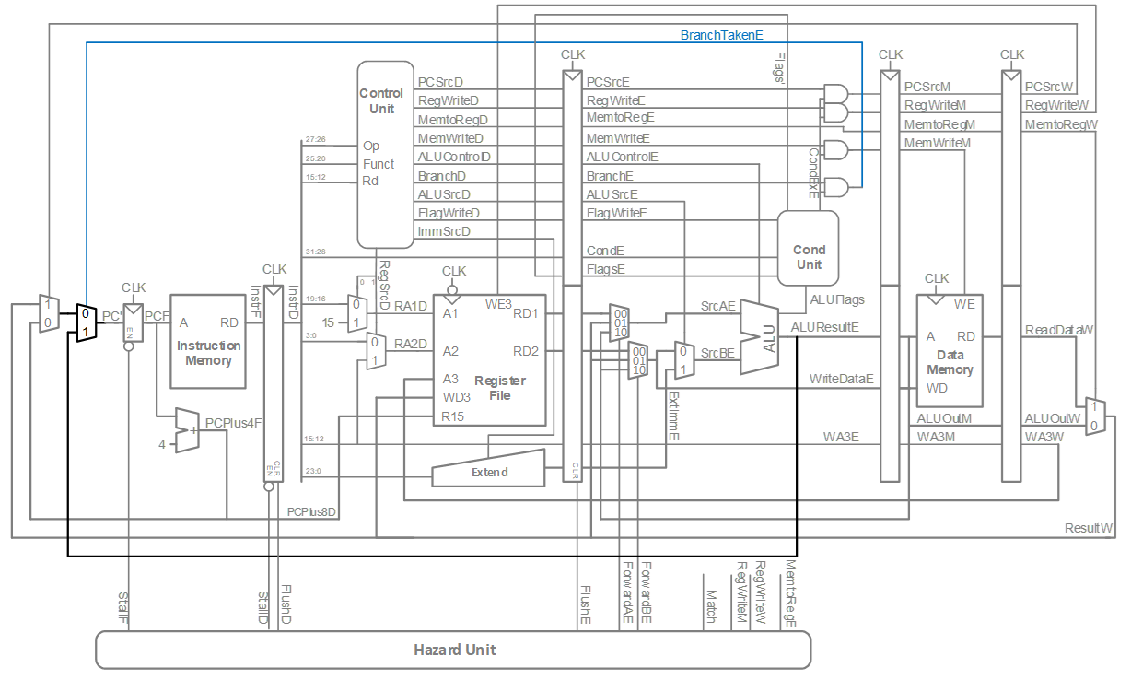
Pipelined processor with Early BTA​

Slide 24
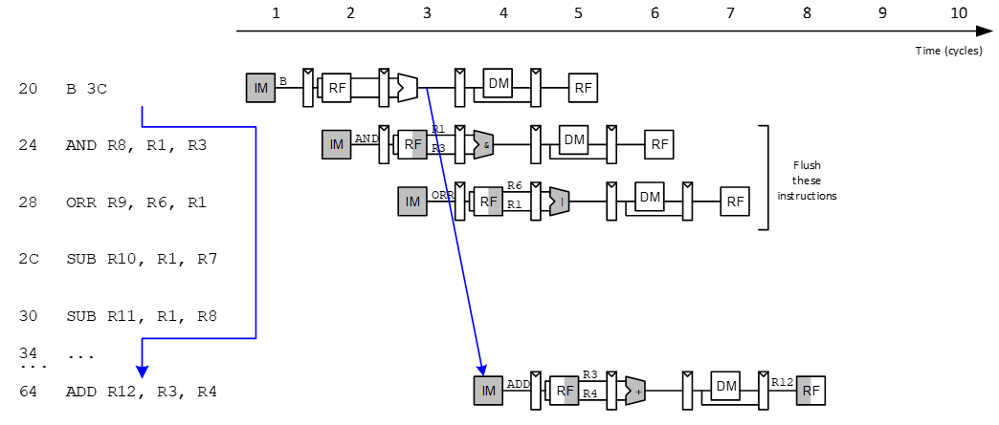
Control Hazards with Early BTA​

Slide 25
Control Stalling Logic​
PCWrPendingF = 1 if write to PC in Decode, Execute or Memory​
PCWrPendingF = PCSrcD + PCSrcE + PCSrcM​
​
Stall Fetch if PCWrPendingF​
StallF = ldrStallD + PCWrPendingF ​
​
Flush Decode if PCWrPendingF OR PC is written in Writeback OR branch is taken​
FlushD = PCWrPendingF + PCSrcW + BranchTakenE​
​
Flush Execute if branch is taken​
FlushE = ldrStallD + BranchTakenE​
​
Stall Decode if ldrStallD (as before)​
StallD = ldrStallD​
​

Slide 26
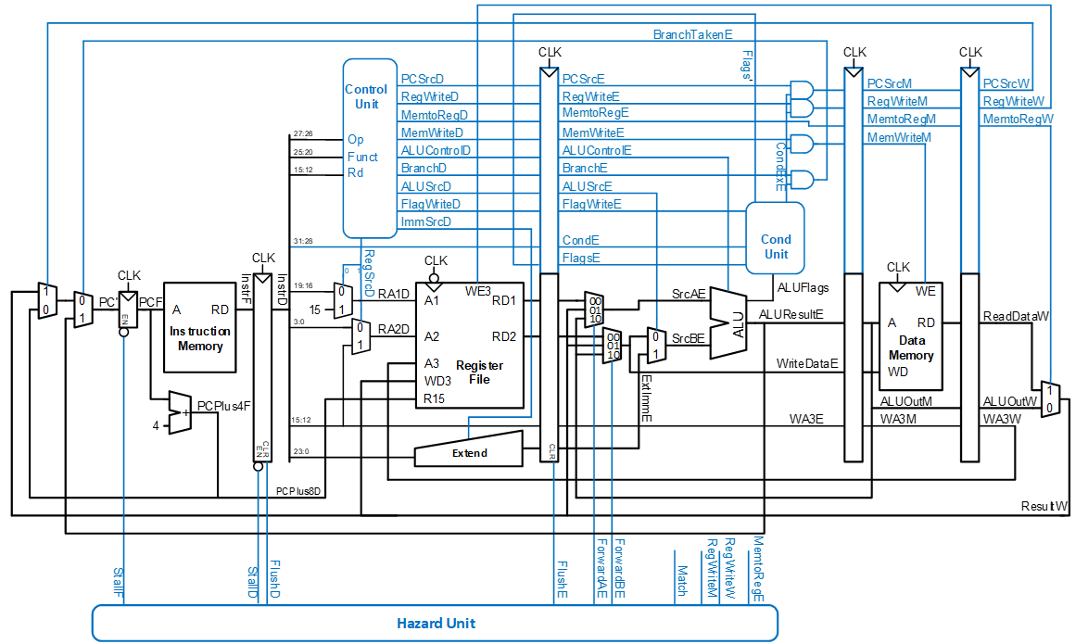
ARM Pipelined Processor with Hazard Unit​

Slide 27
Pipelined Performance Example​
SPECINT2000 benchmark: ​
25% loads​
10% stores ​
13% branches​
52% R-type​
Suppose:​
40% of loads used by next instruction​
50% of branches mispredicted​
What is the average CPI?​

Slide 28
Pipelined Performance Example​
What is the average CPI?​
Load CPI = 1 when not stalling, 2 when stalling​
So, CPIlw = 1(0.6) + 2(0.4) = 1.4​
Branch CPI = 1 when not stalling, 3 when stalling​
So, CPIbeq = 1(0.5) + 3(0.5) = 2​
​
Average CPI = (0.25)(1.4) + (0.1)(1) + (0.13)(2) + (0.52)(1) = 1.23

Slide 29
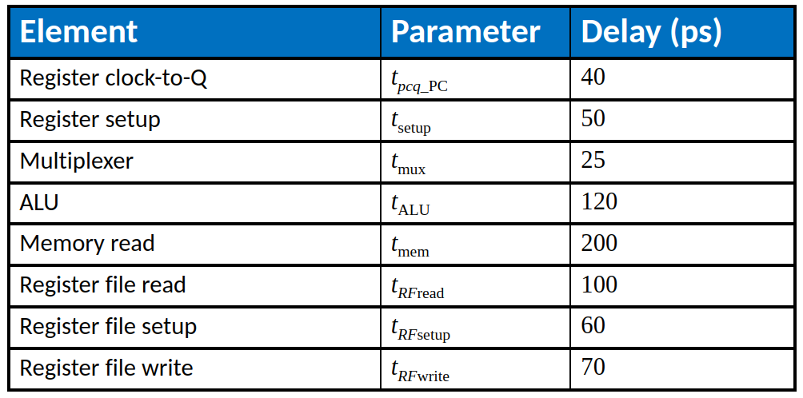
Pipelined Performance​
Pipelined processor critical path:​
Tc3 = max [​tpcq + tmem + tsetup Fetch​
2(tRFread + tsetup ) Decode​
tpcq + 2tmux + tALU + tsetup Execute​
tpcq + tmem + tsetup Memory​
2(tpcq + tmux + tRFwrite) ] Writeback​
Cycle time: Tc3 = ?​

Slide 30
Pipelined Performance​
Pipelined processor critical path:​
Tc3 = max [​tpcq + tmem + tsetup Fetch​
2(tRFread + tsetup ) Decode​
tpcq + 2tmux + tALU + tsetup Execute​
tpcq + tmem + tsetup Memory​
2(tpcq + tmux + tRFwrite) ] Writeback​
Cycle time: Tc3 = = 2(tRFread + tsetup )​
= 2[100 + 50] ps = 300 ps​
​
Program with 100 billion instructions​
Execution Time = (# instructions) × CPI × Tc​
= (100 × 109)(1.23)(300 × 10-12)​ = 36.9 seconds​

Slide 31
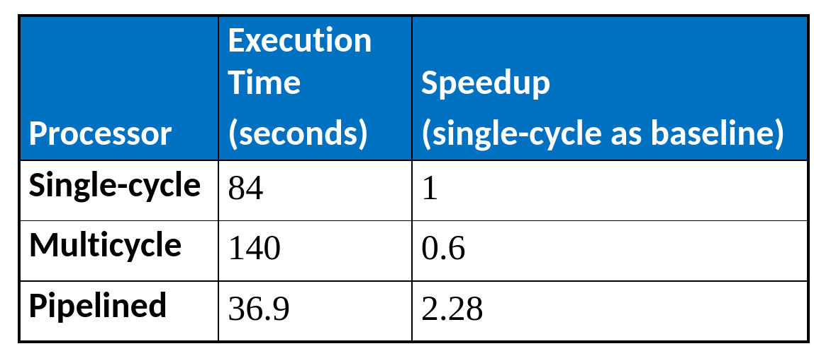
Processor Performance Comparison

Slide 32
Advanced Microarchitecture​
Deep Pipelining​
Micro-operations​
Branch Prediction​
Superscalar Processors​
Out of Order Processors​
Register Renaming​
SIMD​
Multithreading​
Multiprocessors​

Slide 33
Deep Pipelining​
10-20 stages typical​
Number of stages limited by:​
Pipeline hazards​
Sequencing overhead​
Power​
Cost​

Slide 34
Micro-operations​
Decompose more complex instructions into a series of simple instructions called micro-operations (micro-ops or µ-ops)​
At run-time, complex instructions are decoded into one or more micro-ops​
Used heavily in CISC (complex instruction set computer) architectures (e.g., x86)​
Used for some ARM instructions, for example:​
Complex Op Micro-op Sequence​
LDR R1, [R2], #4 LDR R1, [R2]​
ADD R2, R2, #4​
​
Without μ-ops, would need 2nd write port on the register file​

Slide 35
Micro-operations​ …
Allow for dense code (fewer memory accesses)​
Yet preserve simplicity of RISC hardware​
ARM strikes balance by choosing instructions that:​
Give better code density than pure RISC instruction sets (such as MIPS)​
Enable more efficient decoding than CISC instruction sets (such as x86)​

Slide 36
Branch Prediction​
Guess whether branch will be taken​
Backward branches are usually taken (loops)​
Consider history to improve guess​
Good prediction reduces fraction of branches requiring a flush ​

Slide 37
Branch Prediction​
Ideal pipelined processor: CPI = 1​
Branch misprediction increases CPI​
Static branch prediction:​
Check direction of branch (forward or backward)​
If backward, predict taken​
Else, predict not taken​
Dynamic branch prediction:​
Keep history of last several hundred (or thousand) branches in branch target buffer, record:​
Branch destination​
Whether branch was taken​

Slide 38
Branch Prediction Example​
MOV R1, #0 ; R1 = sum​
MOV R0, #0 ; R0 = i​
​
FOR ; for (i=0; i<10; i=i+1)​
CMP R0, #10​
BGE DONE​
ADD R1, R1, R0 ; sum = sum + i​
ADD R0, R0, #1​
B FOR​
​
DONE​

Slide 39
1-Bit Branch Predictor​
Remembers whether branch was taken the last time and does the same thing​
Mispredicts first and last branch of loop​

Slide 40
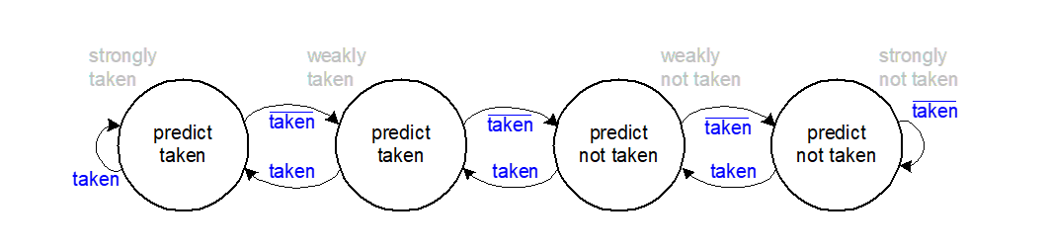
2-Bit Branch Predictor​
Only mispredicts last branch of loop​

Slide 41
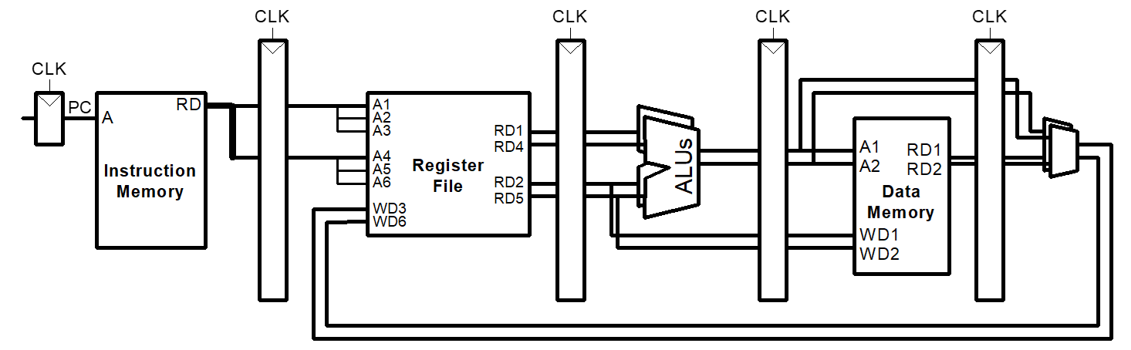
Superscalar​
Multiple copies of datapath execute multiple instructions at once​
Dependencies make it tricky to issue multiple instructions at once​

Slide 42
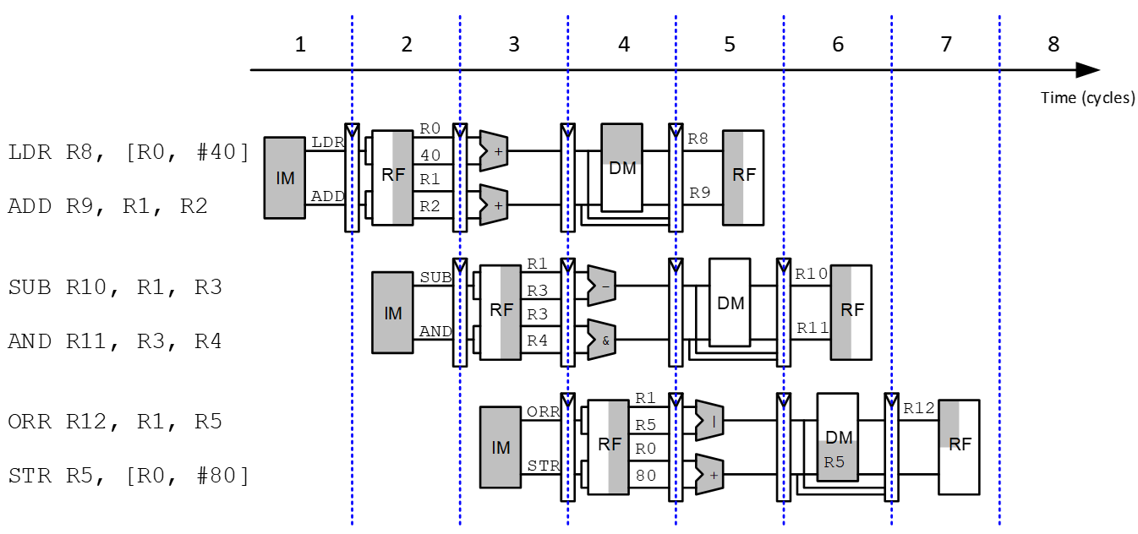
Superscalar Example​
Ideal IPC: 2​
Actual IPC: 2​

Slide 43
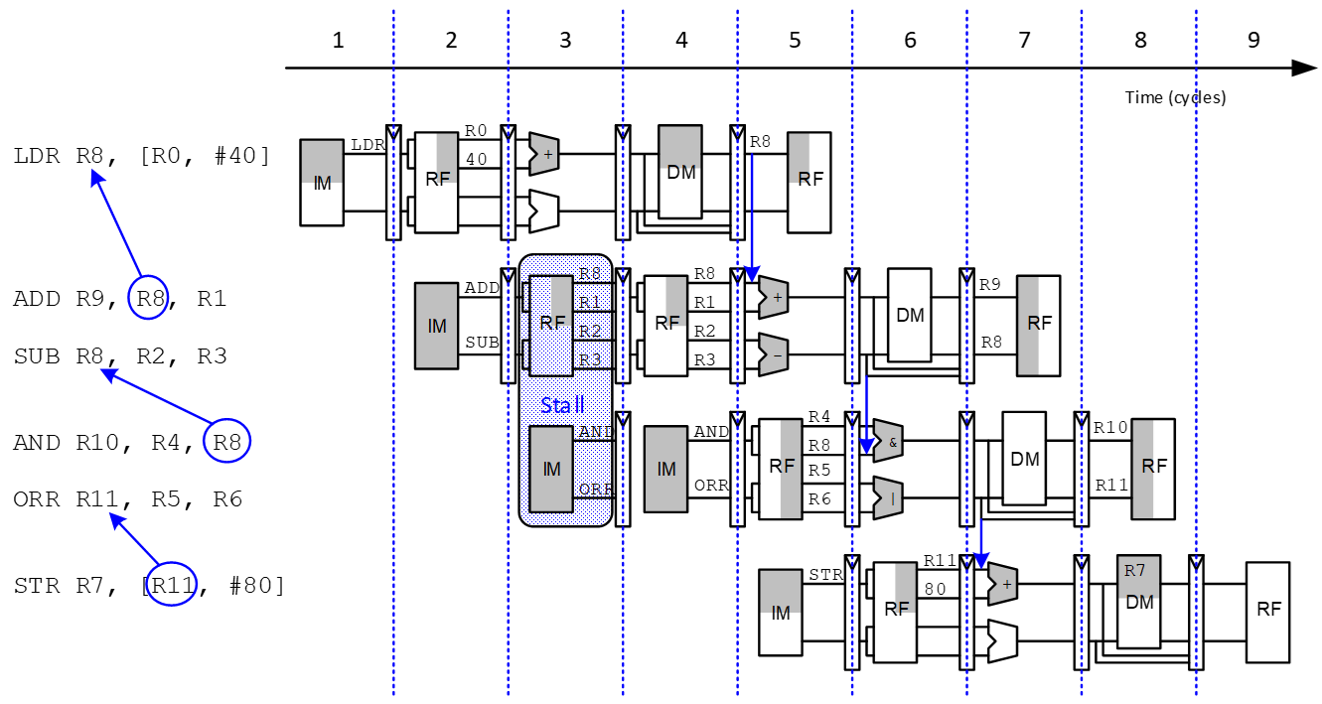
Superscalar with Dependencies​
Ideal IPC: 2​
Actual IPC: 6/5 = 1.2​

Slide 44
Out of Order Processor​
Looks ahead across multiple instructions​
Issues as many instructions as possible at once​
Issues instructions out of order (as long as no dependencies)​
Dependencies:​
RAW (read after write): one instruction writes, later instruction reads a register​
WAR (write after read): one instruction reads, later instruction writes a register​
WAW (write after write): one instruction writes, later instruction writes a register​

Slide 45
Out of Order Processor​
Instruction level parallelism (ILP): number of instruction that can be issued simultaneously (average < 3)​
Scoreboard: table that keeps track of:​
Instructions waiting to issue​
Available functional units​
Dependencies​

Slide 46
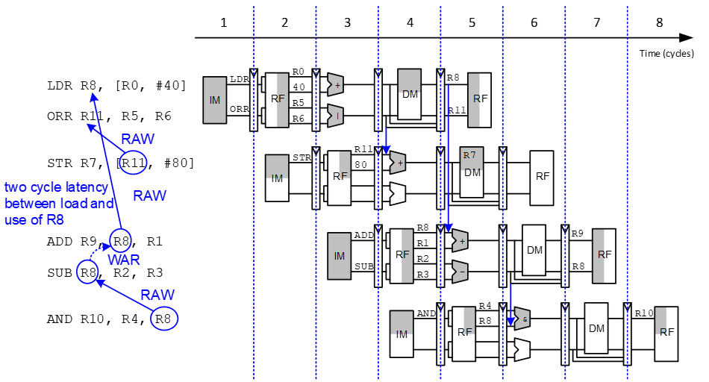
Out of Order Processor Example​
LDR R8, [R0, #40] ​
ADD R9, R8, R1 ​
SUB R8, R2, R3 Ideal IPC: 2​
AND R10, R4, R8 Actual IPC: 6/4 = 1.5​
ORR R11, R5, R6​
STR R7, [R11, #80]​

Slide 47
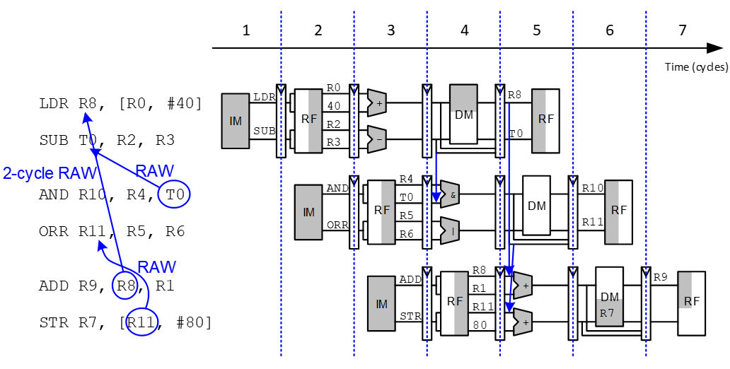
Register Renaming​
LDR R8, [R0, #40] ​
ADD R9, R8, R1 ​
SUB R8, R2, R3 Ideal IPC: 2​
AND R10, R4, R8 Actual IPC: 6/3 = 2​
ORR R11, R5, R6​
STR R7, [R11, #80]​

Slide 48
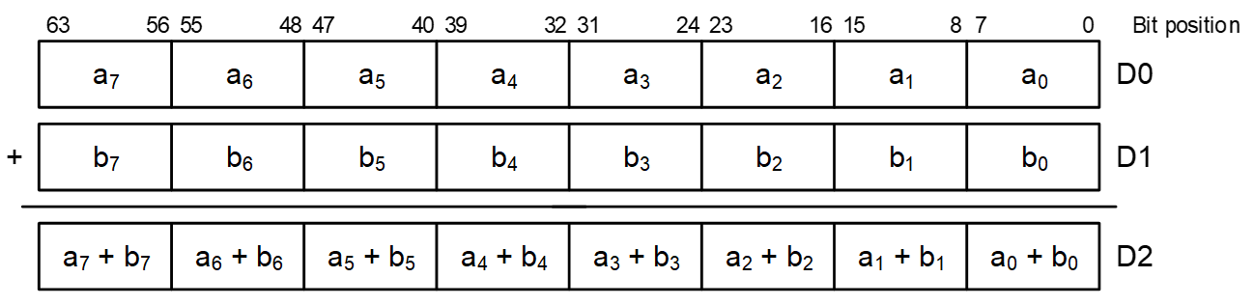
SIMD​
Single Instruction Multiple Data (SIMD)​
Single instruction acts on multiple pieces of data at once​
Common application: graphics​
Perform short arithmetic operations (also called packed arithmetic)​
For example, add eight 8-bit elements​

Slide 49
Advanced Architecture Techniques​
Multithreading​
Wordprocessor: thread for typing, spell checking, printing​
Multiprocessors​
Multiple processors (cores) on a single chip​

Slide 50
Threading: Definitions​
Process: program running on a computer​
Multiple processes can run at once: e.g., surfing Web, playing music, writing a paper​
Thread: part of a program​
Each process has multiple threads: e.g., a word processor may have threads for typing, spell checking, printing​

Slide 51
Threads in Conventional Processor​
One thread runs at once​
When one thread stalls (for example, waiting for memory):​
Architectural state of that thread stored​
Architectural state of waiting thread loaded into processor and it runs​
Called context switching​
Appears to user like all threads running simultaneously​

Slide 52
Multithreading​
Multiple copies of architectural state​
Multiple threads active at once:​
When one thread stalls, another runs immediately​
If one thread can’t keep all execution units busy, another thread can use them​
Does not increase instruction-level parallelism (ILP) of single thread, but increases throughput ​
Intel calls this “hyperthreading”​

Slide 53
Multiprocessors​
Multiple processors (cores) with a method of communication between them​
Types:​
Homogeneous: multiple cores with shared main memory​
Heterogeneous: separate cores for different tasks (for example, DSP and CPU in cell phone)​
Clusters: each core has own memory system​

Slide 54
Additional Readings
Patterson & Hennessy’s: Computer Architecture: A Quantitative Approach​
Conferences:​
ISCA (International Symposium on Computer Architecture)​
HPCA (International Symposium on High Performance Computer Architecture)​
​

